Slide 1
NAIST 4102: NLP 3
Language Modeling
Taro Watanabe
taro@is.naist.jp
NAIST NLP

Slide 2
Schedule
11/5 | Taro Watanabe | Basics about NLP
11/12 | Shohei Higashiyama | Word Segmentation and POS
11/19 | Taro Watanabe | Language Modeling
12/3 | Hidetaka Kamigaito | Conditional Language Modeling
12/10 | Hidetaka Kamigaito | Machine Learning
12/17 | Hiroki Teranishi | Syntactic and Semantic Parsing
12/24 | Yusuke Sakai | Information Extraction and Knowledge Graph
1/7 | Yusuke Sakai | Large Language Models

Slide 3
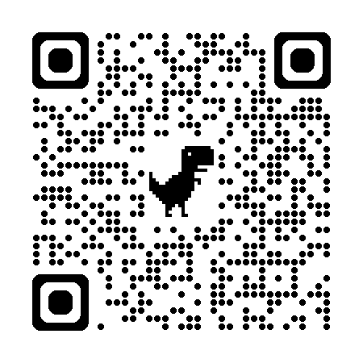
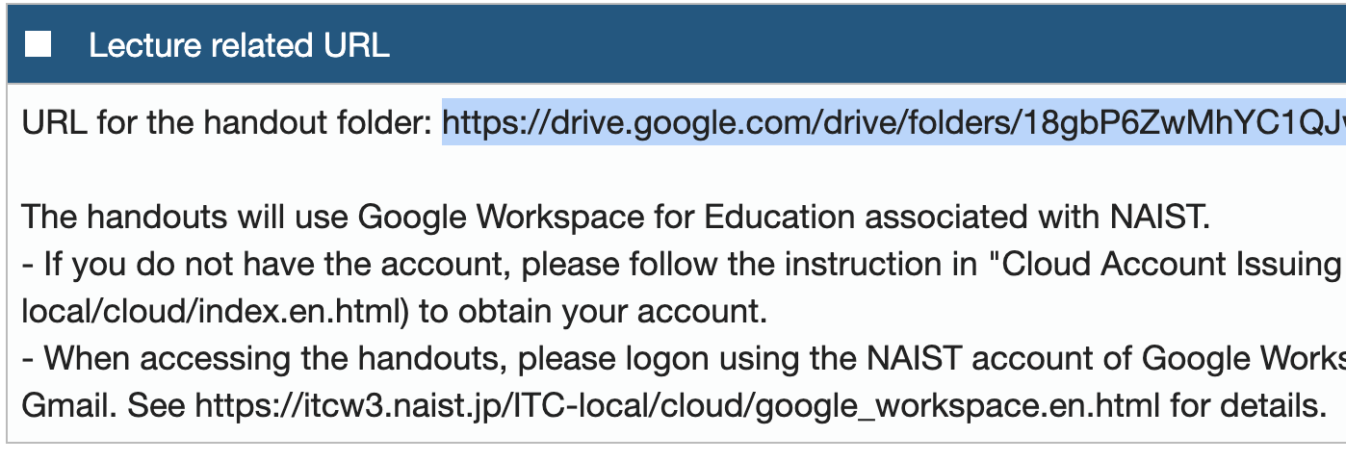
Find the folder for slides
Find the handouts from the Google Drive folder.
Check Lecture Related URL to find the information.

Slide 4
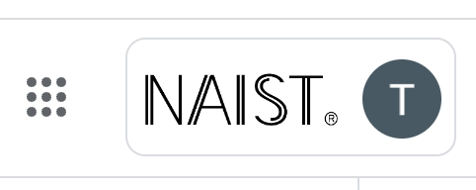
Important!
To access the slides, use Google Workspace issued by NAIST.
https://itcw3.naist.jp/ITC-local/cloud/google_workspace.en.html
Sign in using your Google Workspace account, i.e., {your account name}@g.ext.naist.jp.
Access https://drive.google.com to see if you sign in to the correct account by checking the “NAIST” logo.
If not successful, please ask our TA for help: pussewala.ashmari.ow4 @ naist.ac.jp

Slide 5

Request Access?
I’ll never grant your access for non-NAIST accounts, e.g., gmail.
Do not request access, but switch your account by clicking the email.
Sign-in using {your account name} @g.ext.naist.jp.
Click this email. If confused, ask our TA for help: pussewala.ashmari.ow4 @ naist.ac.jp

Slide 6
What sentence is good?
John is walking his dog.
His walking is John dog.
John are walks a dog.
A dog is walking its John.
John is walking a giraffe.

Slide 7
What words will follow?
Once upon a time, [… ? …]
Once upon a time, there was a little boy [… ? …]
The woman with a very large blue bag walked to [… ? …]
The trophy would not fit in the brown suitcase because it was too [… ? …]
Once upon a time, [… ? …]
Once upon a time, there was a little boy [… ? …]
The woman with a very large blue bag walked to [… ? …]
Once upon a time, [… ? …]
Once upon a time, there was a little boy [… ? …]
Once upon a time, [… ? …]
big
small

Slide 8
Ranking by the probability of a sentence
P(John is walking his dog.) > P(His walking is John dog.)
P(John is walking his dog .)
=
count(John is walking his dog .)
# of sentences in the world
Impossible to count all!

Slide 9
Ranking by the probability of a sentence
P(John is walking his dog.) > P(His walking is John dog.)
P(John is walking his dog .)
= P(John) × P(is | John)
× P(walking | John is) × P(his | John is walking)
× P(dog | John is walking his)
× P(. | John is walking his dog)
count(John is walking)
count(John is)

Slide 10
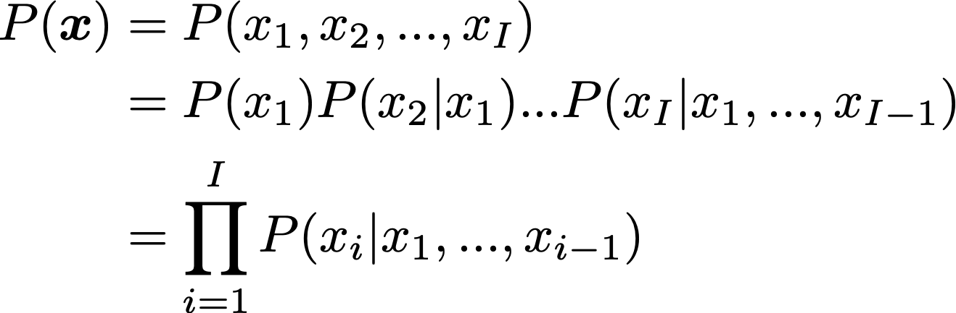
Ranking by the probability of a sentence
P(John is walking his dog.) > P(His walking is John dog.)
Word at the next position
Context or history

Slide 11
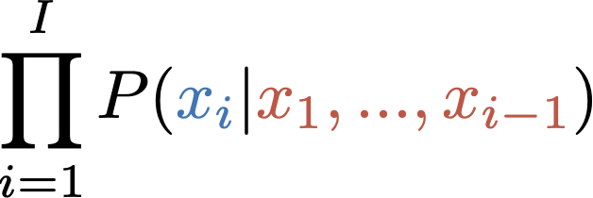
Language Model (LM)
A language model assigns a probability to a sequence of symbols.
Alternatively, it can be regarded as a model which predicts the next symbol given a context.

Slide 12
Predict the next word
Once upon a time, [...?...]
girl
boy
there
and
was
LM computes the probabilities of the next words
Utilizes P(word | context).
Predict the most likely word from all possible words.
P(? | Once upon a time,)

Slide 13
Predict the next word
Once upon a time, there was a little boy [… ? …]
girl
boy
there
and
was
LM computes the probabilities of the next words
Utilizes P(word | context)
Predict the most likely word from all possible words.
P(? |Once upon a time, there was …)

Slide 14
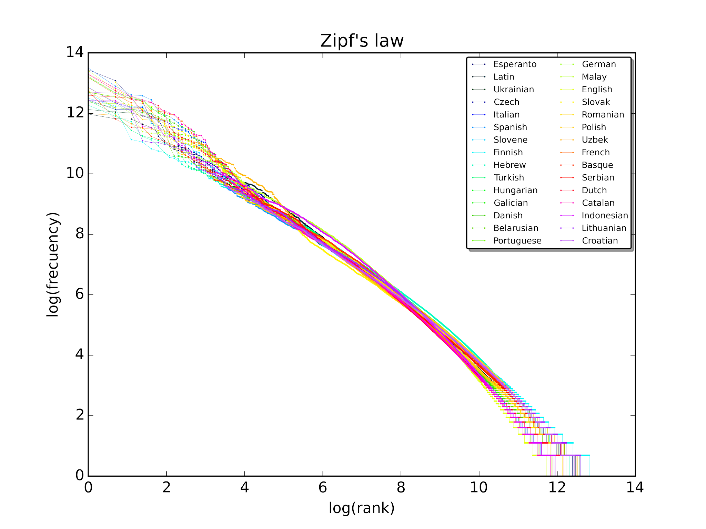
Long tail
https://en.wikipedia.org/wiki/Zipf%27s_law

Slide 15
n-gram Language Models

Slide 16
How to model P(x_{i} | x₁, x₂, …, x_{i-1})?
P(John is walking his dog .)
= P(John) × P(is | John)
× P(walking | John is) × P(his | John is walking)
× P(dog | John is walking his)
× P(. | John is walking his dog)

Slide 17
How to model P(x_{i} | x₁, x₂, …, x_{i-1})?
P(John is walking his dog .)
≈ P(John) × P(is)
× P(walking) × P(his)
× P(dog)
× P(.)

Slide 18
How to model P(x_{i} | x₁, x₂, …, x_{i-1})?
P(John is walking his dog .)
= P(John) × P(is | John)
× P(walking | is) × P(his | walking)
× P(dog | his)
× P(. | dog)

Slide 19
How to model P(x_{i} | x₁, x₂, …, x_{i-1})?
P(John is walking his dog .)
= P(John) × P(is | John)
× P(walking | John is) × P(his | is walking)
× P(dog | walking his)
× P(. | his dog)

Slide 20
How to model P(x_{i} | x₁, x₂, …, x_{i-1})?
P(John is walking his dog .)
= P(John) × P(is | John)
× P(walking | John is) × P(his | John is walking)
× P(dog | is walking his)
× P(. | walking his dog)

Slide 21
How to model P(x_{i} | x₁, x₂, …, x_{i-1})?
P(John is walking his dog .)
= P(John) × P(is | John)
× P(walking | John is) × P(his | John is walking)
× P(dog | John is walking his)
× P(. | is walking his dog)

Slide 22
How to model P(x_{i} | x₁, x₂, …, x_{i-1})?
P(John is walking his dog .)
= P(John) × P(is | John)
× P(walking | John is) × P(his | John is walking)
× P(dog | John is walking his)
× P(. | John is walking his dog)

Slide 23
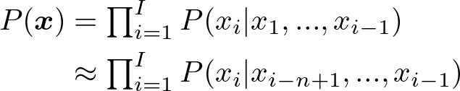
How to model P(x_{i} | x₁, x₂, …, x_{i-1})?
n - 1 word context
Approximation by Markov assumption, i.e., n-grams:
Unigrams: “John” “is” “walking” “his” ...
Bigrams: “John is” “is walking” “walking his” “his dog” ...
Trigrams: “John is walking” “is walking his” “walking his dog” ...
4-grams: “John is walking his” “is walking his dog” ...

Slide 24
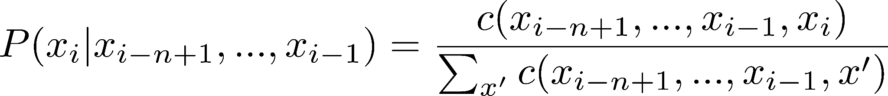
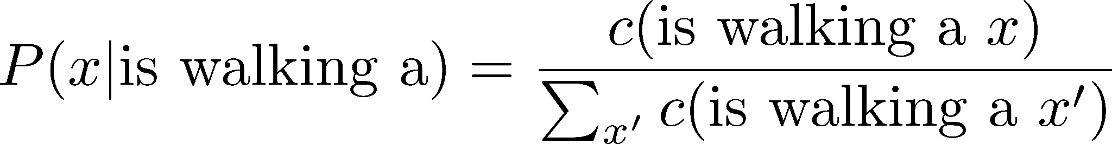
Count-based estimation
Count the n-gram frequency in a large text corpus and divide.
P(dog | is walking a) = 400 / 1,000 = 0.4
P(cat | is walking a) = 50 / 1,000 = 0.05
…

Slide 25
Zero count problem
Numerator is zero: P(giraffe | is walking a) = 0 / 1,000 = 0
Add 1 to counts (Laplace smoothing): (0 + 1) / (1,000 + V)
Denominator is zero: P(a | giraffe is walking) = 0 / 0 = ???
Fallback to shorter ngrams (backoff): P(a | is walking)
Many variants:
Interpolation, Witten-Bell, Katz, Kneser-Ney, modified Kneser-Ney
Optional reading: Chen and Goodman, (1998); Chen and Goodman, (1996)
Vocabulary size

Slide 26
Tasks of LMs
Score sentences
Generate sentences
P(John is walking his dog.) > P(His walking is John dog.)
P(x | <s> John)
P(x | is walking)
P(x | the cat)
P(x | <s>)
P(x | John is)
P(x | walking the)
End when the special symbol is sampled.
Start from the special symbol.
<s>
John
is
walking
the
cat
</s>

Slide 27

Evaluate LMs
Log-likelihood (↑):
Per-word (cross) entropy (↓):
Perplexity (↓):

Slide 28
Variants of LMs
Share similarity: class LM
Discontiguous context: skip-gram LM
Long distance: cache, trigger, dependency LMs
Topics and types: mixture LM
Optional reading: Goodman (2001)
P(ANIMAL | BE V-ing Det) P(dog | ANIMAL)
P(dog | is walking *)
P(dog | John …….. a)
P(dog | <news> is walking a)

Slide 29
Log-linear Language Models

Slide 30
Feature-based models
Scores for words x given a context “walking a”: s(x | walking a)
Score for x given “walking” at the 1st position
Score for x given “a” at the 2nd position
Score for x given “V-ing Det“ in the context
A list of words in x
Bias score for x
s(x | walking a)
a
the
John
Mary
dog
cat
giraffe
…
4.5
3.5
0.5
0.5
1.0
1.0
-1.0
…
-0.5
-0.8
-1.0
-1.0
4.0
2.0
1.0
…
-1.5
-1.8
-2.0
-2.0
2.0
2.0
1.5
…
-2.0
-2.1
-1.0
-1.0
1.0
1.0
1.0
…
0.5
-1.2
-3.5
-3.5
8.0
6.0
2.5
…
+
+
+
=

Slide 31
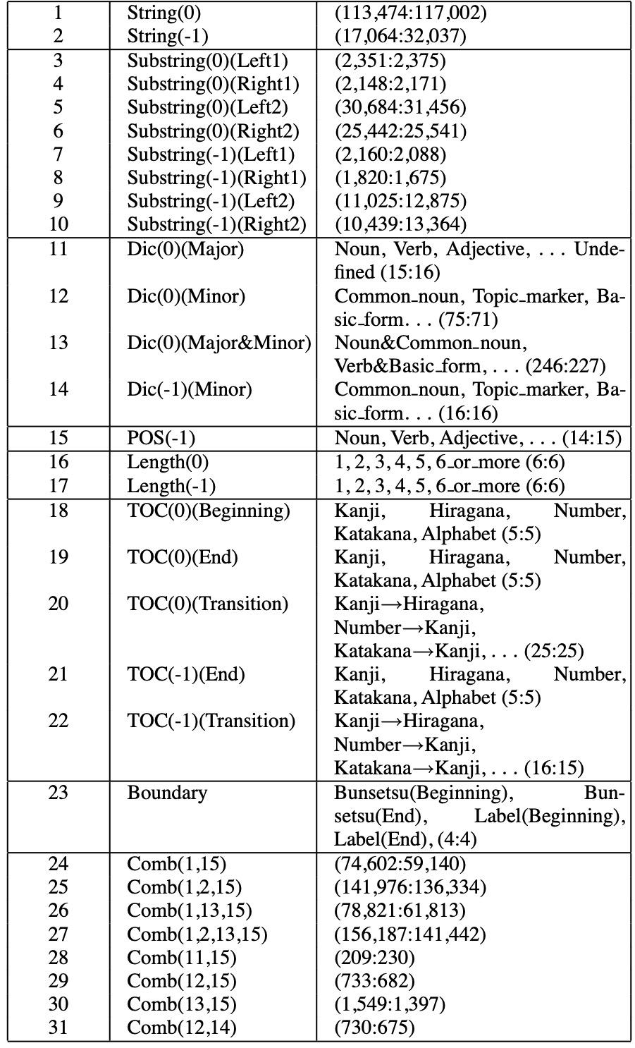
Examples of Japanese Features
strings
Prefix/suffix of a word
Feature-based model for the morphological analysis of Japanese data.
A set of templates to instantiate features, e.g., Kanji/Hiragana sequences.
Dictionary entry
Combination of features
(Uchimoto et al., 2003)

Slide 32
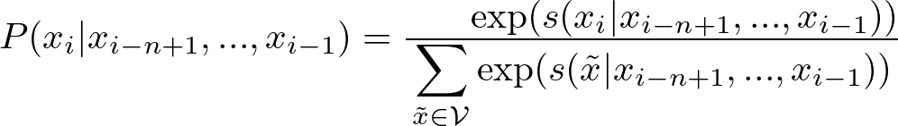
Convert scores as probabilities
Takes exponent and normalizes it to compute probabilities, i.e., softmax (Berger et al., 1996).
0.5
-1.2
-3.5
-3.5
8.0
6.0
2.5
…

Slide 33
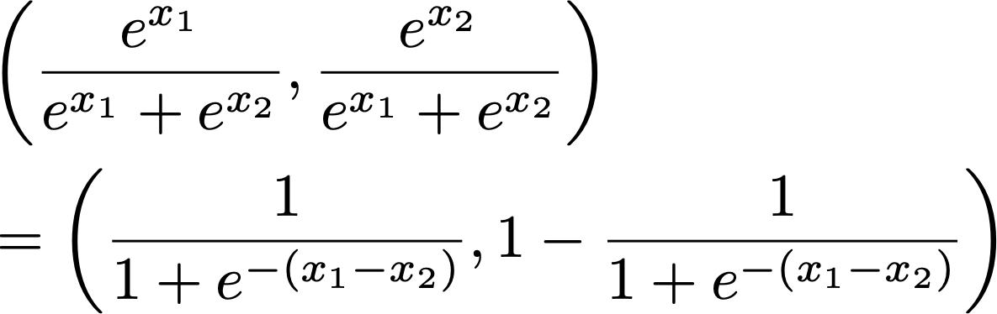
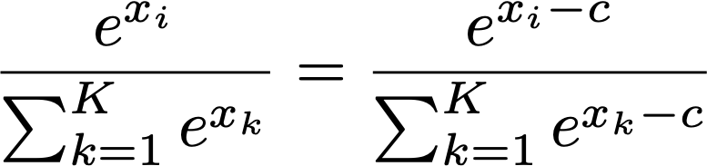
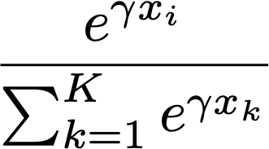
What is softmax?
K-dim vector to probability distribution
Reduced to sigmoid function when K = 2
Invariant to biases. This trick is used for GPU computation.
A smoother arg max when the scale parameter γ → ∞ and uniform when γ → 0.

Slide 34
Computation in Details
W_{b}
W_{walking, _}
W_{_, a}
W_{V-ing, Det}
softmax
summation
+
+
+
Lookup parameters
a
the
John
Mary
dog
cat
giraffe
…
4.5
3.5
0.5
0.5
1.0
1.0
-1.0
…
-0.5
-0.8
-1.0
-1.0
4.0
2.0
1.0
…
-1.5
-1.8
-2.0
-2.0
2.0
2.0
1.5
…
-2.0
-2.1
-1.0
-1.0
1.0
1.0
1.0
…
V: vocabulary size
F: feature size
= W ∈ R^{V × F}

Slide 35
Training: Loss function
1 for x_{i}, 0 otherwise
For training, computes a loss function, e.g., cross-entropy loss, and updates parameters to reduce the loss.
x_{i}

Slide 36


Training: Suffer loss
Backpropagation to compute the derivative of the loss function wrt the parameters.
Stochastic gradient descent (SGD) to update the parameters.
Learning rate
x_{i}

Slide 37
Training: backpropagation in details
W_{b}
W_{walking, _}
W_{_, a}
W_{V-ing, Det}
+
+
+
a
the
John
Mary
dog
cat
giraffe
…
4.5
3.5
0.5
0.5
1.0
1.0
-1.0
…
↓
↓
↓
↓
↑
↓
↓
…
-0.5
-0.8
-1.0
-1.0
4.0
2.0
1.0
…
↓
↓
↓
↓
↑
↓
↓
…
-1.5
-1.8
-2.0
-2.0
2.0
2.0
1.5
…
↓
↓
↓
↓
↑
↓
↓
…
-2.0
-2.1
-1.0
-1.0
1.0
1.0
1.0
…
↓
↓
↓
↓
↑
↓
↓
…
= W

Slide 38
Log-linear modeling
Log-linear modeling allows rich features with smaller space.
Count-based models: O(V^{n})
Log-linear models: O(V F) where F = # of features, e.g., walking at the 1st position.
Sparsity problem:
More features, e.g., three word combinations, for better capacity, but demands more memory.
Note: the similar problem exists in count-based models, i.e., n.

Slide 39
Neural Language Models

Slide 40
Exploit vector representation of words
tanh
softmax
Instead of W ∈ R^{V × F}, employ E ∈ R^{m × V} as features (m << V and V << F).
Feature combination is represented through matmul, bias and activation, e.g., tanh.
Back to V dimension via matmal, then, softmax.
E_{walking}
H
b
U
+
E_{a}
E
It is a simpler version of (Bengio et al., 2003)

Slide 41
Benefits of Neural LMs based on Feed-forward Neural Networks.
Similar contexts gets similar representations
Similar outputs get similar softmax.
Feature combination by matmul: no n-gram storage
tanh
softmax
Share similar meanings/semantics via vectors for every input words: embeddings
E_{walking}
H
b
U
+
E_{a}
Remaining problems: Fixed n. Sentences do not have length limits.
E
It is a simpler version of (Bengio et al., 2003)

Slide 42
Recurrent Language Models

Slide 43
Long-distance dependencies
Complicated dependence:
The trophy would not fit in the brown suitcase because it was too big.
The trophy would not fit in the brown suitcase because it was too small.
Agreement in gender, number or categories.
The man with a very large blue bag walked to his car.
The woman with a very large blue bag walked to her car.
(Winograd Schema Challenge)

Slide 44
Recurrent Neural Networks (RNNs)
Feed-forward NN
Recurrent NN
output label
output label
softmax
softmax
Recurrent connection
transform
transform
embedding
embedding
input context
input context
(Elman, 1990)

Slide 45
RNN as LM
(Mikolov et al., 2010)
matmul + bias + activation using shared parameters
3-gram context is represented implicitly
hidden states
label₁
label₂
label₃
label₄
softmax
softmax
softmax
softmax
h₀
h₁
h₂
h₃
h₄
transform
transform
transform
transform
E_{<s>}
E_{John}
E_{is}
E_{walking}

Slide 46
Training an RNN
Backpropagation through time
loss₁
loss₂
Gradients are aggregated in each step
loss₃
loss₄
label₁
label₂
label₃
label₄
softmax
softmax
softmax
softmax
h₀
h₁
h₂
h₃
h₄
transform
transform
transform
transform
E_{<s>}
E_{John}
E_{is}
E_{walking}

Slide 47
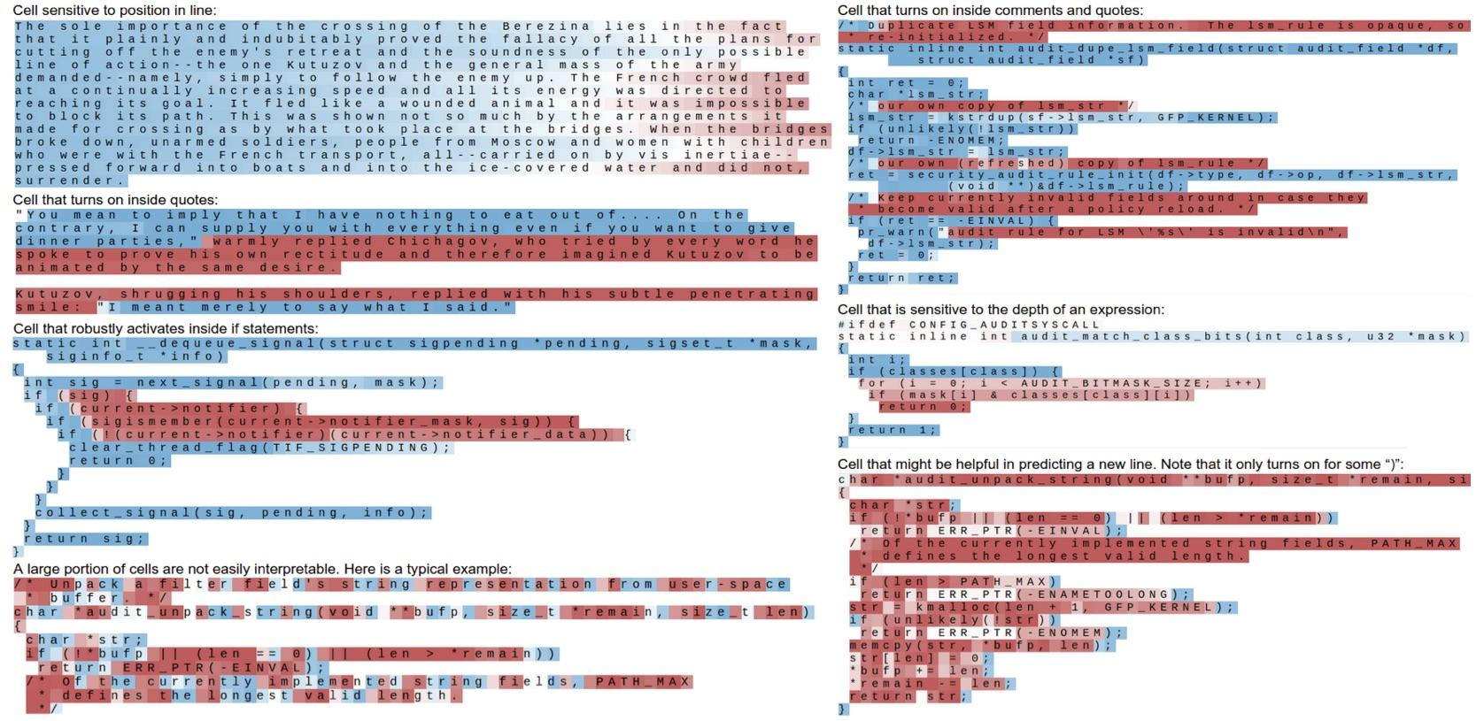
What is represented by an LSTM (an instance of RNNs): Structures?
(Karpathy et al., 2016)

Slide 48
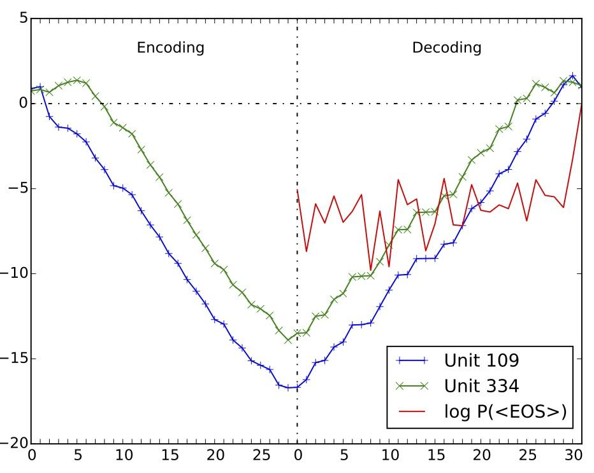
What is represented by an LSTM (an instance of RNNs): Output length?
(Shi et al., 2016)

Slide 49
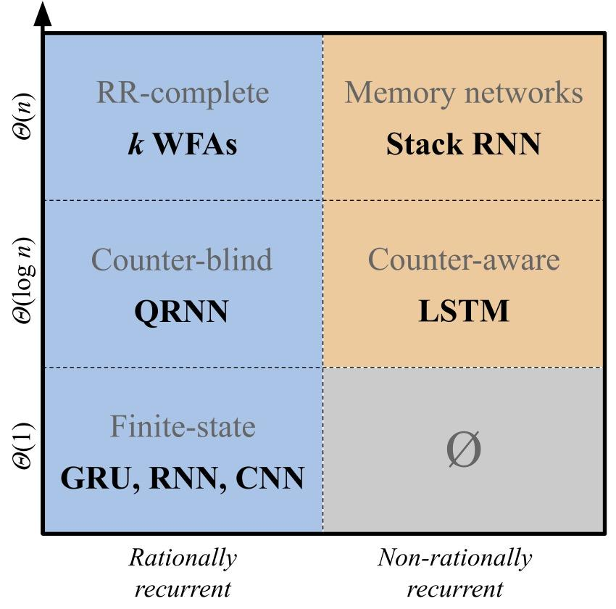
What is represented by an LSTM (an instance of RNNs): Capacity of RNN
RNN is Turing-complete (Siegelmann and Sontag, 1992)
Rationally Recurrent (Peng et al., 2018): Forward computation by WFA
Counter Machine (Discher 1966): Closed under +, -, ×
Stack RNN (Suzgun et al., 2019): Additional differentiable stack in each state
(Merrill et al., 2020)

Slide 50
Self-Attention Language Models

Slide 51
RNN as LM
(Mikolov et al., 2010)
Every state can look at only previous state.
label₁
label₂
label₃
label₄
softmax
softmax
softmax
softmax
h₀
h₁
h₂
h₃
h₄
transform
transform
transform
transform
E_{<s>}
E_{John}
E_{is}
E_{walking}

Slide 52
Self-Attention for LM: GPT-2 and its successors
(Radford et al., 2019; Brown et al., 2020)
Every state can look at all previous states.
Representation comes from lower layers.
label₁
label₂
label₃
label₄
softmax
softmax
softmax
softmax
h₁
h₂
h₃
h₄
transform
transform
transform
transform
E_{<s>}
E_{John}
E_{is}
E_{walking}

Slide 53
Masked LM with self-attention: BERT and its variants
It is not a language model, but we can compute “pseudo-likelihood.” See (Salazar et al., 2020)
(Devlin et al., 2019)
Masking for a position and predict the word at that position
label₂
States from all the positions.
softmax
h₁
h₂
h₃
h₄
transform
transform
transform
transform
E_{<s>}
E_{MASK}
E_{is}
E_{walking}

Slide 54
Attention
Representation is projected as query, key & value.
Weights for query “walking”
Query
Weighted sum of representations (values).
For each query, a weight (= similarity) for every key is computed.
Re-interpreting representations across context (Vaswani et al., 2017).
Key
×
a₄₁
×
a₄₂
×
a₄₃
Value
＋
＋
＋
×
a₄₄
<s>
John
is
walking
Weighted sum of values = new representation for “walking”

Slide 55
Attention
For each query, computes weights and sums values.
Query
Weighted sum of representations (values).
For each query, a weight (= similarity) for every key is computed.
Re-interpreting representations across context (Vaswani et al., 2017).
Key
Value
×
a₁₁
<s>

Slide 56
Attention
Weights are probabilistic, ∑_{j} a_{ij} = 1, e.g., a₂₁ + a₂₂ = 1.
Query
Weighted sum of representations (values).
For each query, a weight (= similarity) for every key is computed.
Re-interpreting representations across context (Vaswani et al., 2017).
Key
Value
×
a₂₁
＋
×
a₂₂
<s>
John

Slide 57
Attention
Query
Weighted sum of representations (values).
For each query, a weight (= similarity) for every key is computed.
Re-interpreting representations across context (Vaswani et al., 2017).
Key
Value
×
a₃₁
＋
×
a₃₂
＋
×
a₃₃
<s>
John
is

Slide 58
Attention
Query
Weighted sum of representations (values).
For each query, a weight (= similarity) for every key is computed.
Re-interpreting representations across context (Vaswani et al., 2017).
Key
×
a₄₁
×
a₄₂
×
a₄₃
Value
＋
＋
＋
×
a₄₄
<s>
John
is
walking

Slide 59
Attention Computation
a₁₁
Value
a₂₁
a₂₂
V
Attention is efficiently computed with matrix multiplication in parallel.
Mask out invalid positions for A, e.g., a₁₂.
a₃₁
a₃₂
a₃₃
a₄₁
a₄₂
a₄₃
a₄₄
A (weights)
Query
Key
A = softmax(QK⟙ + M)
Softmax for each row, i.e., ∑_{j} a_{ij} = 1, e.g., a₂₁ + a₂₂ = 1.
Mask, e.g., -inf for invalid positions, e.g., a₁₂.

Slide 60
Self-Attention Language Model
Access to a long context when predicting a token.
Computational complexity: O(I²) (I = length)
A faster implementation (Dao, 2024)
Attention can be regarded as recurrence (Feng et al., 2024)
Relation to formal language (Strobl et al., 2024)

Slide 61
Summary
n-gram Language Models
Log-linear Language Models
Neural Language Models
Recurrent Language Models
Self-attention Language Models

Slide 62
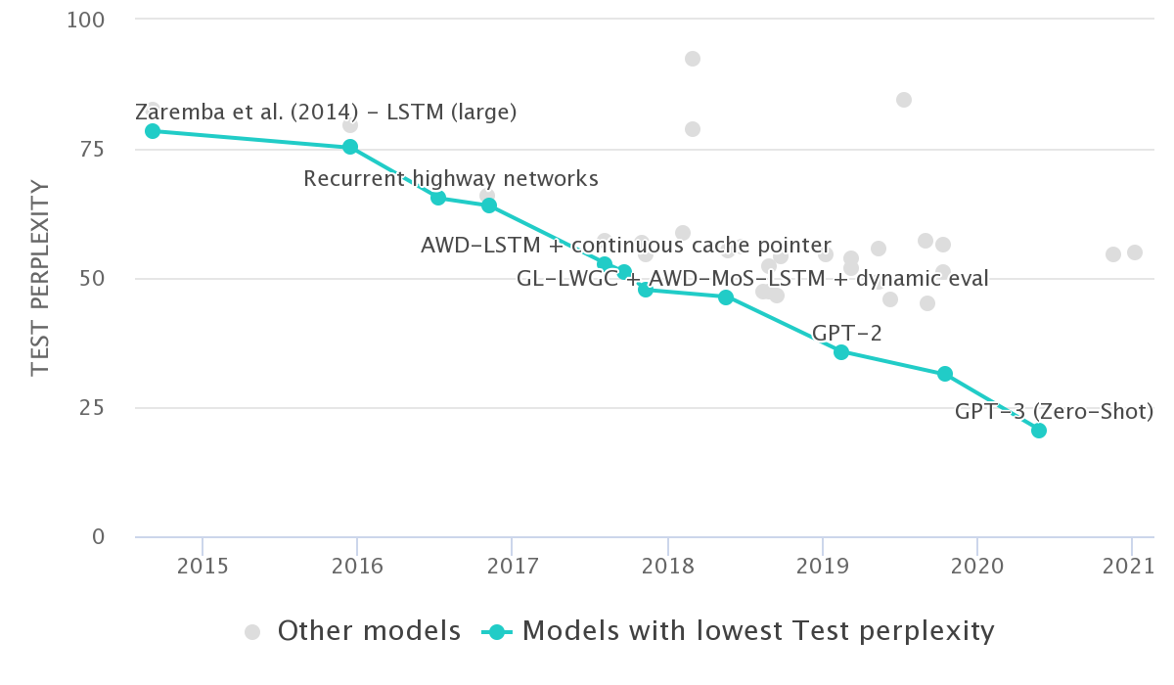
Why LM?
Used as a component of NLP tasks, especially for generation and probability computation.
Benchmark for understanding language: competition
paperwithcode.com
Popular research directions
Transformation, softmax, more parameters, initialization, optimization algorithm.
Optional readings in paperwithcode.com.

Slide 63
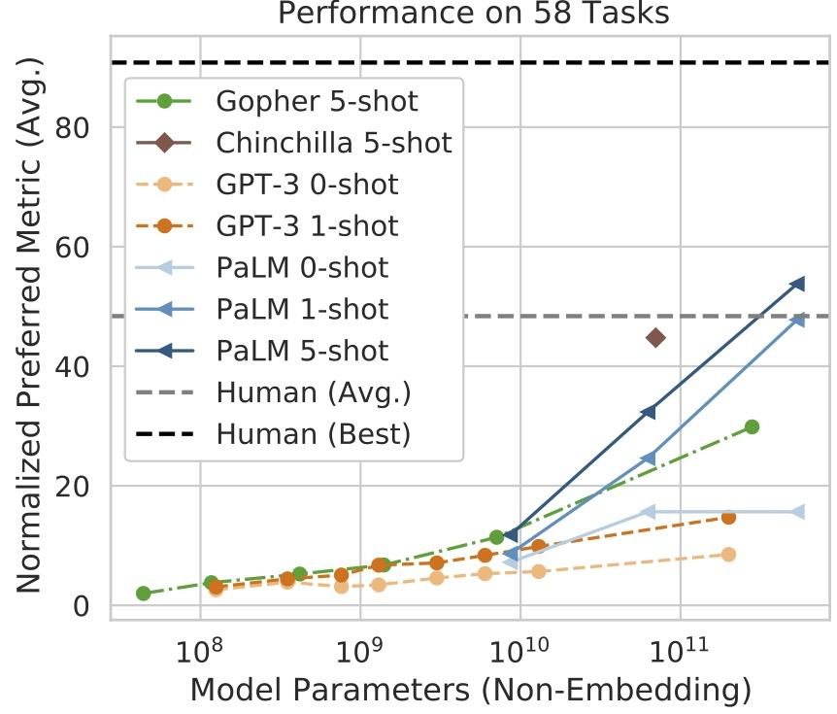
Why LM?
Learned representations are exploited/abused in many downstream tasks.
Pre-training a LM on huge text data.
Fine-tuning for specific tasks, e.g., QA or dialogue.
(Chowdhery et al., 2022)

Slide 64
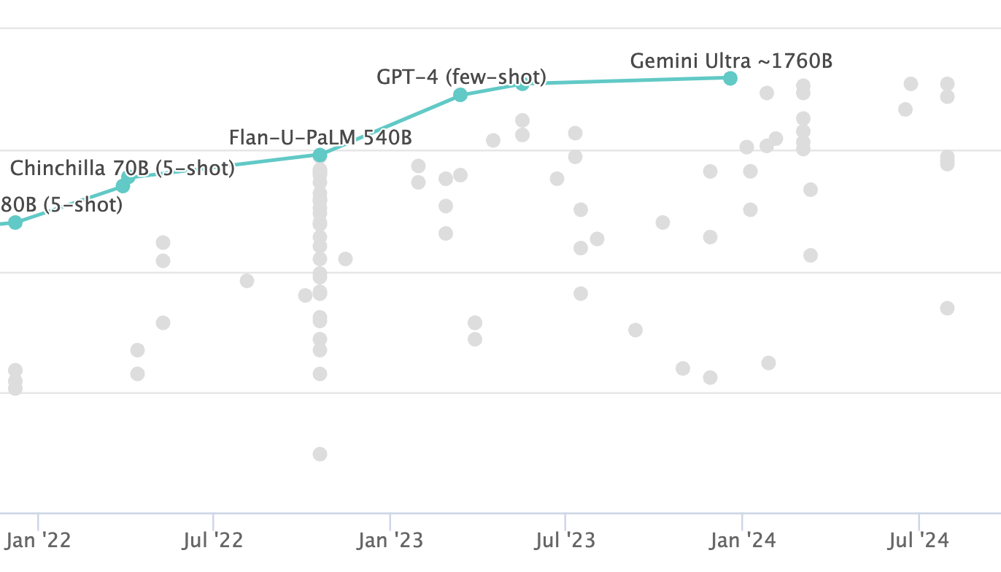
Why LM?
Surpassing human experts (89.8%) by Gemini Ultra.
Zero-shot and few-shot by leveraging in-context learning capabilities.
https://paperswithcode.com/sota/multi-task-language-understanding-on-mmlu

Slide 65
Large Language Models (LLMs)

Slide 66
How to train an LLM?
Pre-training
Instruction Tuning
Alignment
Pre-training: Train a model to predict next words from human written texts.
Instruction Tuning: Tune a model to predict appropriate outputs for a task.
Alignment: Train a model to predict outputs which align human values.

Slide 67

Pre-training
Predict the words in a sentence. Predict the words in the next sentence. Predict the words in the next sentence. Again, predict the words in the next sentence. Predict the words of sentences in other documents….
From many data (100B 〜 1.5T words), train a model with large # of parameters (e.g., 70B).
Acquire knowledge from texts.
Also learn artificial languages (e.g., codes).
Acquire knowledge by reading books (?)

Slide 68

Instruction Tuning
Please tell me how to create lecture slides.
A lecture is a style of class in which a teacher prepare a note…
Learned to output following user’s instructions.
Pre-training solely does not answer, but simply generate following words.
Tuned on various tasks, e.g., MT, not only QA.
❌
Following are the steps to create lecture slides.
Clarify the objectives…..
✅
Evaluate the generation result, either good or bad.

Slide 69
Alignment
Please tell me how to create a bomb.
Following are the steps to create a bomb.
Clarify the objectives...
Train a model, not to generate output against human values.
Train a model so that Good output > Bad output (RLHF, DPO)
Traina a model in terms of Helpfulness, Honest, Harmless.
❌
I’m unable to answer the question.
✅
Should not answer even if it is easy to search answers.

Slide 70
LLM: Why next token prediction?
Supervised Training
Large amount of human created textual data in the web.
Similar to the human knowledge acquisition process (?)
Generation Model
Extract knowledge by letting the model generate following texts.
Similar to the human inference capabilities (?)

Slide 71
LLM: Why large computation resources?
Once upon a time, [...?...]
Learn to assign: higher probability for correct prediction
lower probability for incorrect prediction
girl
boy
there
and
was
P(? | Once upon a time,)
Learn parameters such that it can predict next words accurately.
Mechanism for learning
Efficiency for parallel computation

Slide 72
Mechanism for Learning
Read texts in each step.
Update parameters
Learning by updating parameters several times.
More efficient learning by predicting as many tokens as possible in a single update.
Efficient parallel computations by a single GPU
The more data, the more efficient learning.

Slide 73

Parallel Computation
Split data for parallel computation
Computer
GPU is good in parallel computation, but it has small memory.
Split a single model among multiple GPUs.
Copy a model to multiple servers, and split data among those servers.
Bottleneck in transfer between GPU and servers.
Data
Copy model parameters

Slide 74
LLM: Demands large computation
An example for Llama 3 70B
More than 11 days for ideal condition.
Text data | 15T tokens
GPU hours | 64K hours
# of GPUs | 24,000 H100 GPUs
Power | 700W (per GPU)
1,900 tCO2eq = 31 flights between NYC and London
https://github.com/meta-llama/llama3/blob/main/MODEL_CARD.md
https://x.com/jacobaustin132/status/1781361188460241108

Slide 75
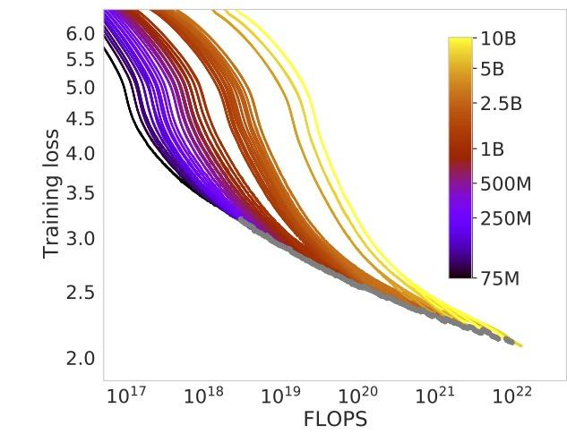
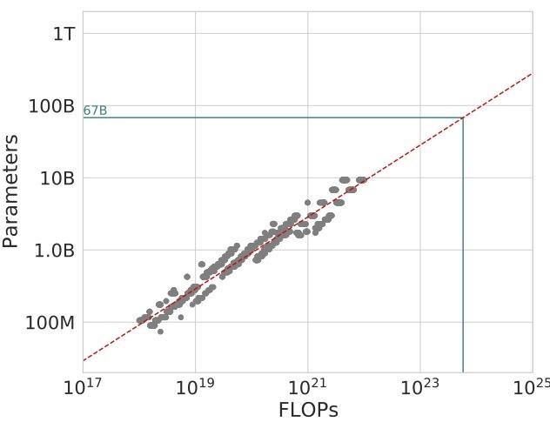
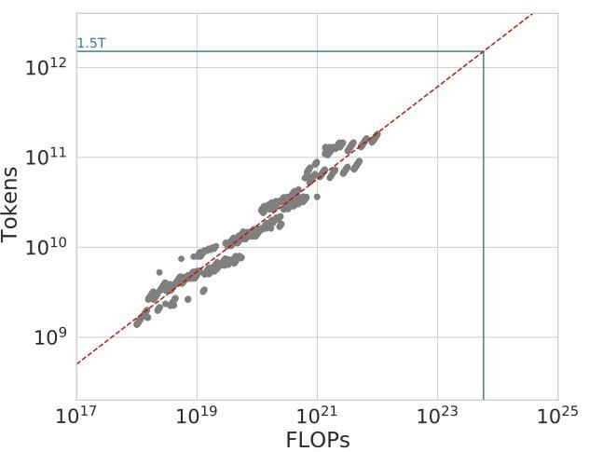
Efficiency
Compute and performance
Compute and data
Relation of model performance, the number of parameters and data scale.
Bigger the better!
We need large resources: Llama 3 70B (6.4M GPU)
How to improve the efficiency?
Compute and parameters
https://arxiv.org/abs/2203.15556

Slide 76
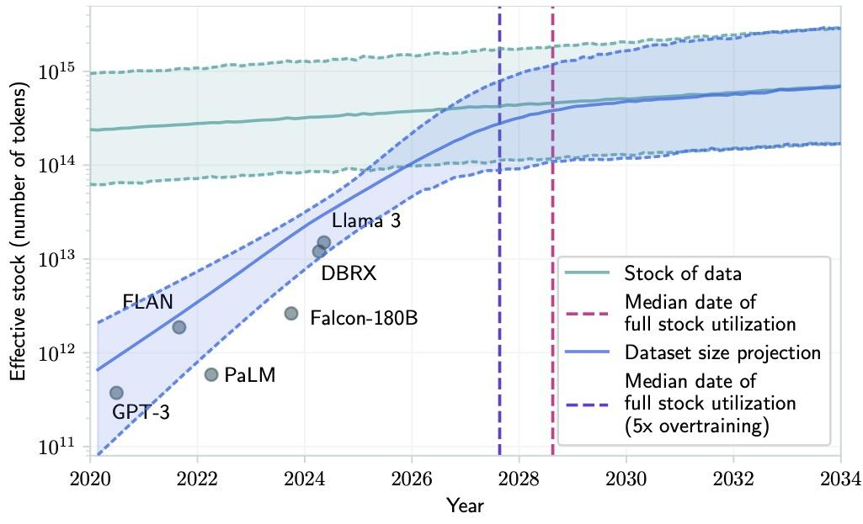
Data Outage
We are running out of training data.
Quantity to quality?
Exploit AI generated data?
Transfer from different modalities?
https://arxiv.org/abs/2211.04325

Slide 77
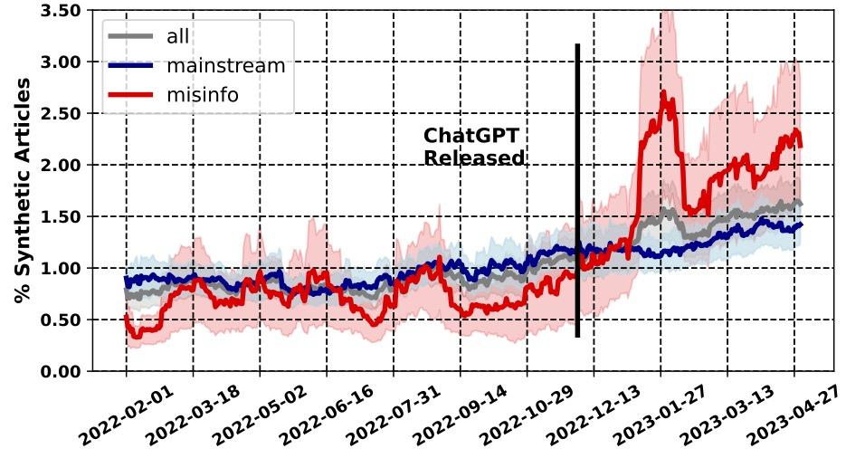
Data proliferation
Spread of artificially created articles after ChatGPT.
50% are created by AI (Hanley and Durumeric, 2024)
It is hard to differentiate them (Puccetti et al., 2024)
https://ojs.aaai.org/index.php/ICWSM/article/view/31333

Slide 78
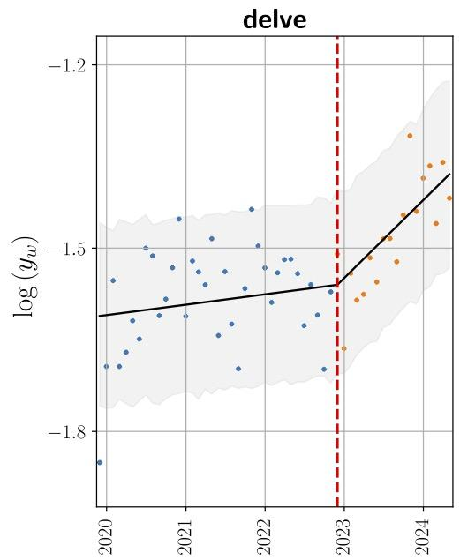
Impact to human languages
ChatGPT has an impact to how human use languages.
YouTube data clearly shows “delve” appearing after the launch (Yakura et al., 2024).
Impact to appearing or disappearing expressions.
https://arxiv.org/abs/2409.01754

Slide 79
Questions?

Slide 80
Optional Reading List
Neubig (2017), “Neural Machine Translation and Sequence-to-Sequence Models: A Tutorial” (Section 3-6)
Goldberg (2016), “A Primer on NN Models for NLP”
Others
Chen and Goodman (1998), “An Empirical Study of Smoothing Techniques for Language Modeling”
Brown et al. (1992), “An Estimate of an Upper Bound for the Entropy of English”

Slide 81
Assignment
Identify a language of a text by a byte-wise language model.
Access the Colab notebook, tweak the code, run experiments, write answers and print it out as a PDF.
Submit the PDF to https://edu-portal.naist.jp/. We do not accept other formats. Due by December 19th 2025.
Assessment is based on your codes and results.
Fixing a bug + report the language of unk.test file.
Please find the details in the colab.

Slide 82
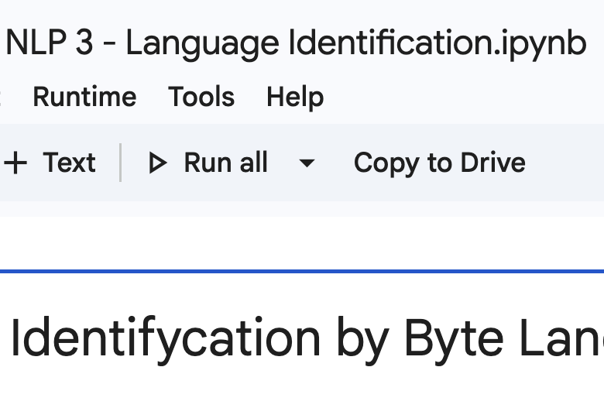
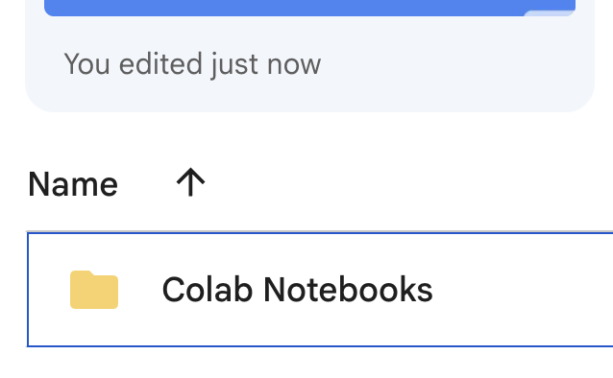
Copy to Drive
You do not have write permission to the notebook.
Copy to Drive to keep a copy in your drive.
You need to sign in using your Google Workspace account issued by NAIST.
Find your copies at https://drive.google.com

Slide 83
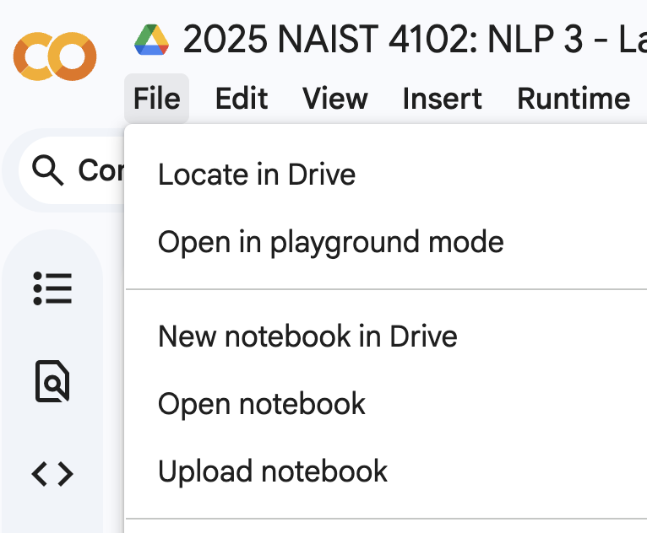
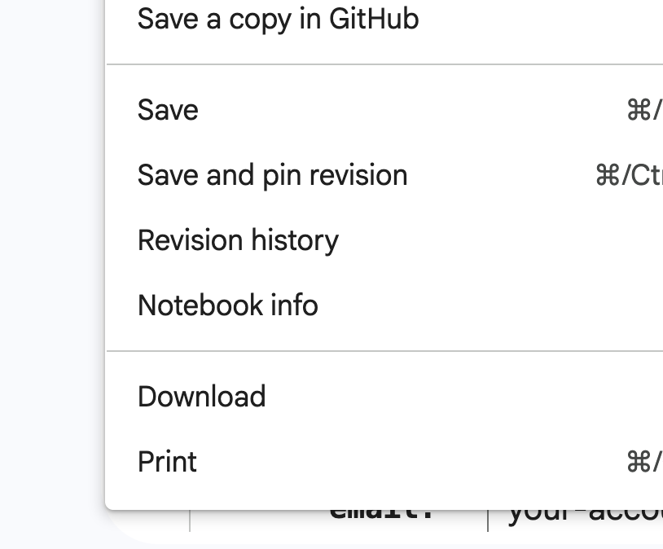
Print out as a PDF
Click the File menu and print it as a PDF.
Submit the PDF to https://edu-portal.naist.jp/. Violating the file format requirement implies zero score.
Due by December 19th 2025.

